Slide 1

/Group04
CS 201- Data Structures and Algorithms
3 MBC PAYROLL
SYSTEM
Project Presentation|

Slide 2

Contents
Introduction
Objectives
Screenshots
Credits

Slide 3

Introduction
The 3MBC Payroll System is designed to digitize the current manual systems used by companies nowadays. It was developed to help the manager/administrator to arrange the employees' salaries in a more efficient, secure, and timely manner. It encrypts sensitive data and information and enables storage over an extended length of time while allowing for easy access and modification. This system can keep and view digital records without obtaining redundant entries. The project comprises how to manage employees' data effectively and provide enhanced services to employees.

Slide 4
Objectives
1
2
3
4
5
Provide 3MBC Administration with an interactive graphical user interface for calculating, preparing, and managing employee records, payments, and salaries for all 3MBC Company employees.
Ensure that system administrators only have secure access to employee details and payroll records.
Maintain accurate information of employee’s earnings, contributions, deductions, and necessary withholdings.
Maintain accurate information of employee’s earnings, contributions, deductions, and necessary withholdings.
Maintain accurate information of employee’s earnings, contributions, deductions, and necessary withholdings.
Notes:
Bullet form

Slide 5
Screenshots
Employee Attendance
Admin Login
Dashboard
Payroll
About Us
Exit

Slide 6
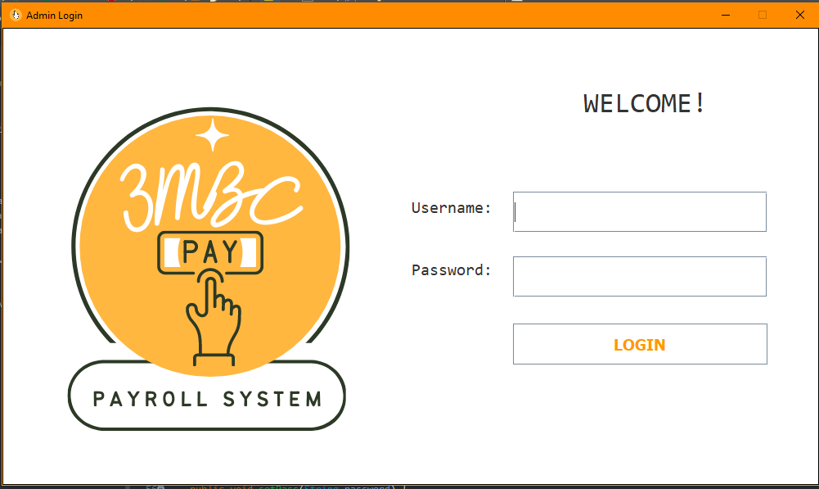
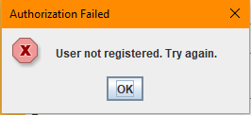
Admin Login
Algorithm Used:
Array List

Slide 7
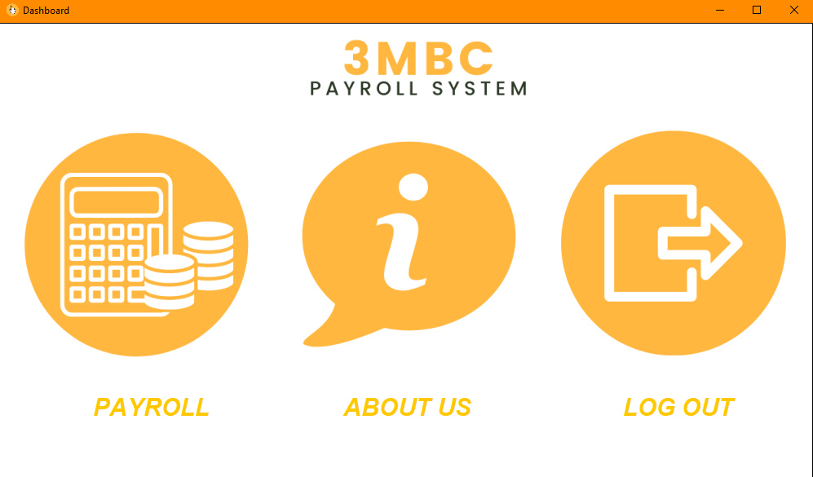
Dashboard
Algorithm Used:
Notes:
This is not done yet

Slide 8
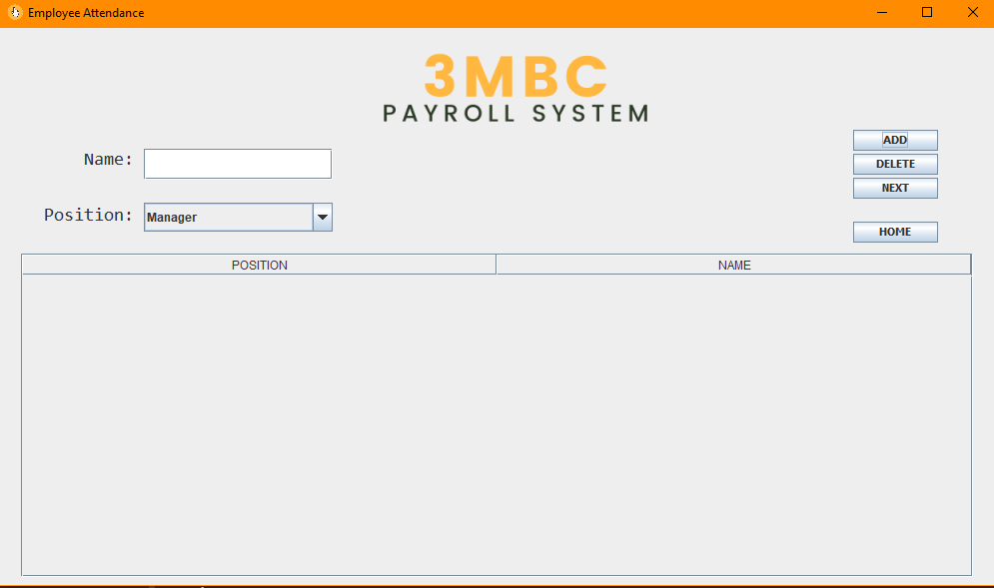
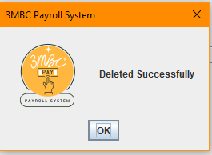
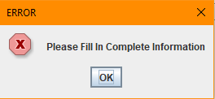
Employee Attendance
Algorithm Used:
Linked List
Array

Slide 9
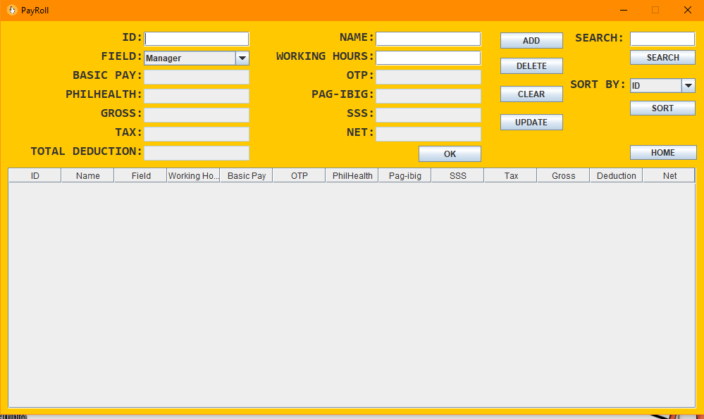
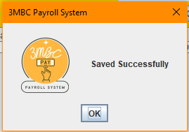
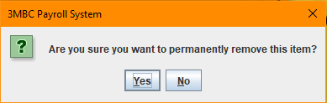
Payroll
Algorithm Used:
Array
Stack
Queue
Tree
Sort (Quick Sort)
Notes:
This is not done yet

Slide 10
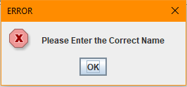
Payroll
Algorithm Used:
Array
Stack
Queue
Tree
Sort (Heap Sort)
Notes:
This is not done yet

Slide 11
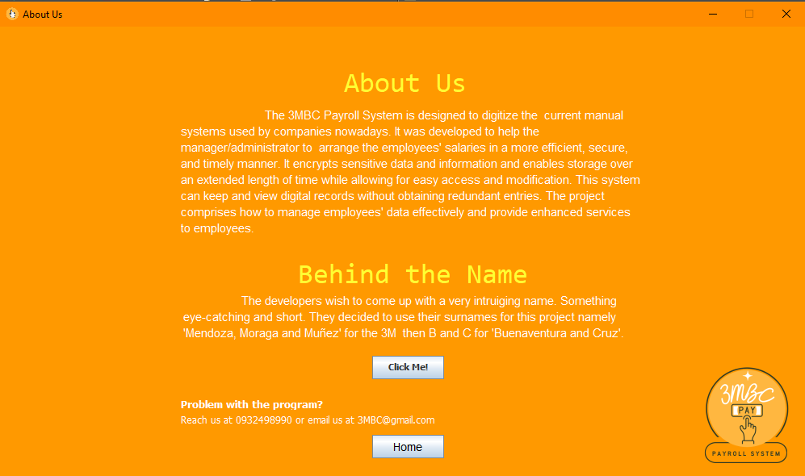
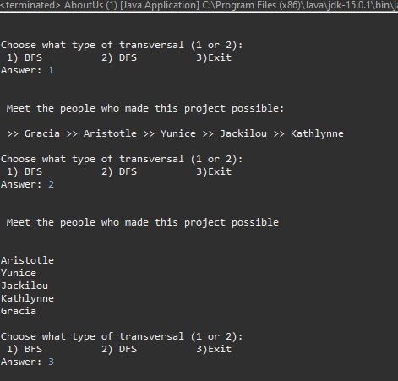
About Us
Algorithm Used:
Graph

Slide 12
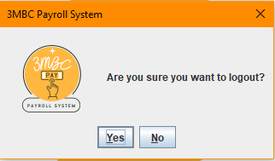
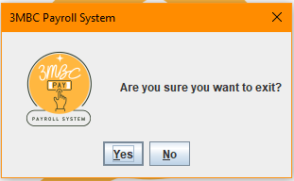
Exit
Algorithm Used:

Slide 13
Presented by
Gracia C. Menodza
Aristotle C. Buenaventura
Yunice Nicole Cruz
Manager
Main Programmer 1
Main Programmer 2
Jackilou Munez
Kathlynne Joy Moraga
Sub Programmer
System Analyst/Designer
Project Presentation |

Slide 14
Project Presentation |
Thank you!

